Slide 1
Pteridophytes General Characteristics
Class Teacher
Dr. Hannnan Mukhtar
Assistant Professor
Department of Botany
Lahore College for Women University, Lahore Pakistan.
Course Description
Course Title: DIVERSITY OF PLANTS
Course code: Min/Bot-102
Credit hours: 4 (3+1)
Class
Course : BS I, 2nd Semester
Major: Zoology
Minor course: Botany

Slide 2
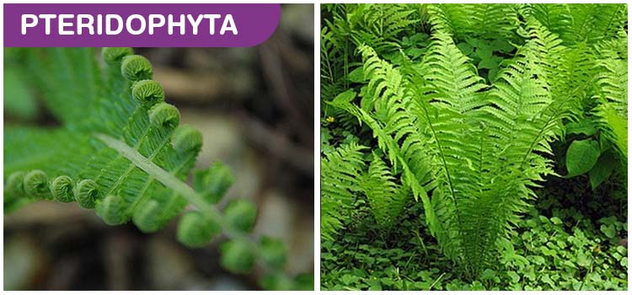

Slide 3
Scientific classification
Kingdom: | Plantae
Division: | Pteridophyta
Includes:
Lycopodiophyta Polypodiophyta

Slide 4
Pteridophyta Classification
Pteridophyta can be classified into:
Lycopodiopsida
Lycopodiidae (club mosses)
Selaginellidae (quillworts, spike mosses)
Polypodiopsida
Psilotidae: Ophioglossales (e.g. grape ferns) and Psilotales (whisk ferns).
Equisetidae (horsetails)
Polypodiidae (leptosporangiate ferns, the most species-rich group)
Marattiidae (marattioid ferns)

Slide 5
Pteridophyta Characteristics
1. Pteridophytes are the first true land plants:
It is speculated that life began in the oceans, and through millions of years of evolution, life slowly adapted on to dry land. And among the first of the plants to truly live on land were the Pteridophytes.
2. They are seedless, vascular cryptogams:
Pteridophytes are seedless, and they procreate through spores. They don’t have conducting tissues for transportation of water and minerals. Instead, the water and minerals flow from the surface of the plant- cell to cell in the plant’s body. This is also one of the reasons why these plants need a constantly moist environment to survive.
3. They show true alternation of generations:
The sporophyte generation and the gametophyte generation are observed in Pteridophytes.
4. Sporophyte has true roots, stem and leaves:
They contain vascular tissues.

Slide 6
5. Spores developed in sporangia are homosporous or heterosporous:
The sporangium is the structures in which spores are formed. They are usually homosporous (meaning: one type of spore is produced) and are also heterosporous, (meaning: two kinds of spores are produced.)
6. Sporangia are produced in groups on sporophylls:
Leaves that bear the sporangia are termed as sporophylls.
7. Young leaves of sporophyte show circinate vernation:
The tip of the leaves tends to curl inwards to protect the vulnerable growing parts.
8. Sex organs multicellular and jacketed:
The male sex organs are called antheridia, while the female sex organs are called archegonia.
Source: https://byjus.com/biology/pteridophyta/

Slide 7
Life Cycle of Pteridophyta
Similar to the life cycle of seed plants, the pteridophytes also involves the alternation of generations in its life cycle. However, the pteridophytes differ from mosses and seed plants in that both generations are independent and free-living. The sexuality of pteridophytic gametophytes can be classified as follows:
Dioicous: the individual gametophyte is either a male producing antheridia and sperm, or a female producing archegonia and egg cells.
Monoicous: every individual gametophyte may produce both antheridia and archegonia and it can function both as a male as well as a female.
Protandrous: the antheridia matures before the archegonia.
Protogynous: the archegonia matures before the antheridia.

Slide 8
Pteridophyta Examples (Source: https://byjus.com/biology/pteridophyta/)
Following are the important examples of Pteridophyta:
Whisk Fern
Flying Spider
Dicksonia sellowiana
Salvinia natans
Lophosoria quadripinnata
Equisetidae
Man fern
Silver fern
Conclusion
Pteridophyta is one of the older groups of plants present in the plant kingdom. They have been around far longer than the angiosperms, with earliest ever recorded fossil dating back to the Silurian Period. Furthermore, they are one of the very first “true” plants to adapt to life on land.
Primary characteristics of Pteridophytes are as follows: They are seedless, vascular plants that show true alternation of generations. Furthermore, the sporophyte has true roots, stem and leaves. Moreover, the spores developed in sporangia are either homosporous or heterosporous.
Life Cycle of Pteridophyta is almost the same as seed-bearing plants, where alternation of generations is observed. However, pteridophytes do not possess seeds; instead, they use spores.

Slide 9
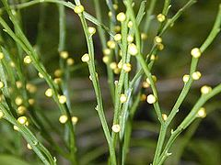
Psilotum
Scientific classification
Kingdom: | Plantae
Clade: | Tracheophytes
Class: | Polypodiopsida
Order: | Psilotales
Family: | Psilotaceae
Genus: | Psilotum Sw.
Closeup of Psilotum nudum

Slide 17
References
Source:
http://premabotany.blogspot.com/2018/12/psilotum-classification-structure-of.html
https://en.wikipedia.org/wiki/Psilotum
http://www.biologydiscussion.com/botany/pteridophyta/psilotum-features-reproduction-and-phylogeny/46152

Slide 18
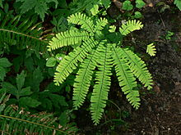
Adiantum
Scientific classification
Kingdom: | Plantae
Clade: | Tracheophytes
Class: | Polypodiopsida
Order: | Polypodiales
Family: | Pteridaceae
Subfamily: | Vittarioideae
Genus: | Adiantum L.
(Adiantum aleuticum)

Slide 19
Occurrence and Distribution of Adiantum
Adiantum is popularly called ‘Maiden hair fem’ because of the shiny black rachis of the leaves. It is one of the most widely distributed genera (Other genera are Cheilanthes, Pellaea, Ceratopieris and Anogramma) of the family growing luxuriantly in both tropical and sub topical regions of the world. It grows ubiqui­tously wherever nature offers a moist, shaded locality. There are nearly 200 species.
Sporophyte of Adiantum
Morphology of the plant: The sporophytic plant body consists of an under­ground rhizome from which are produced leaves and roots. The rhizome is covered with chaffy scales (Paleae). It may be erect , semi erect, or creeping.

Slide 20
The rhizome may be hard or soft and brown in colour.
The chaffy scales that cover the rhizome are of various shapes and sizes.
The roots are stiff and black in colour. Occasionally they may be branched.
The leaves are produced in acropetalous succession on the creeping rhizome. They show circinate vernation typical of ferns. The rachis of the leaf is hard, wiry, shiny and black or dark brown in colour thus giving the name maiden hair fern. The rachis has a medium dorsal groove, and is covered with paleae at the basal region. In addition to this, glandular hairs may also be present.
The leaves may be unipinnate (Axaudatum) or bi or tri-pinnate as in , A. capillus – veneris . The pinnae are stalked and have a dichotomous venation. The rachis may terminate in a pinna or may bear a bud. In A capillus veneris the rachis divides pinnately and the ultimate branches bear pinnae in an alternate fashion.
There is no distinction between fertile and sterile leaves in Adiantum. The whole leaf may be sporangiferous or only certain pinnae may bear sporangia. The soral organisa­tion is very evident. Sori are borne on the ventral surface of the pinnae.
Source: http://www.biologydiscussion.com/pteridophytes/adiantum-occurrence-and-gametophyte-botany/73629

Slide 22
Internal Structure
Root
A transection reveals the usual three zones epidermis, cortex and stele. The outline of the section would be wavy. Epidermis is single layered and the cells may be thin walled or thick walled. There is a cuticle external to the epidermis.
Cortex lies internal to the epidermis. It may be wholly parenchymatous (A. rubellum), For it may have sclerenchyma and parenchyma.
The central vascular cylinder exhibits great variety. In the young condition the stele may be a solenostele. In A. rubellum the stele is a typical amphiphloic solenostele, with characteristic features such as outer endodermis, outer pericycle, outer phloem, xylem, inner phloem, inner pericycle and inner endodermis lining the parenchymatous pith.

Slide 24
2. Leaf:
The petiole shows an epidermis, parenchymatous cortex and the vas­cular trace. There is a thick walled hypodermis next to the epidermis. The number of leaf traces entering the leaf, varies. Even when there are two leaf traces, both of them unite further up resulting in a single bundle. The xylem is concave at the base but triradiate higher up with three protoxylem groups. Xylem is exarch.
The mesophyll (when present) as well as the epidermal layers are chlorophyllous. The epidermal layers are chlorophyllous. The epidermal cells over the veins are thick walled. The stomata are scattered throughout the surface of the leaf. Paleae or ramenta may be borne even on the epidermis of the lamina. The vein may or may not have a bundle sheath. The vascular tissues show the characteristic X\P arrangement.

Slide 26
3. Root:
A transection shows a very prominent piliferous layer, a two zoned cortex and the central protostele. The piliferous layer has brown coloured cell walls. Cortex has an outer parenchymatous zone and an inner sclerotic zone.
Surrounding the stele is a conspicuous endodermis with prominent casparian thickenings. The xylem is exarch and diarch, phloem completely surrounds the xylem. External to phloem is a single layered pericycle.
Reproduction:
Vegetative propagation is brought about by buds produced at the leaf tips. The buds enter the ground when the leaf bends and touches the soil. There they develop into a new individual. This, in turn may repeat the process leading to the walking Habit. Walking habit is seen in A caudatum.
Spore Producing Organs:
As has already been said there is no distinction into fertile and sterile leaves. The sori are born at the distal end of the pinnae. But the sori are not exactly marginal. They are borne a little behind the tip of the veins. The sorus bearing margin of the leaf incurls and forms the false inducium.

Slide 27
Development and Structure of the Sporangium:
A mature sporangiuim has a stalk made up of three rows of cells. The stalk terminates in a globose or biconvex capsule. The wall is single layered.
There is an obliquely vertical annulus of 12-24 cells long. The annulus is separated from the stalk by two or three cells. The stomium also is separated from both the stalk, and the annulus. The rest of the sporangial wall is composed of a few large cells. The sporangium dehisces transversely liberating the spores. All the spores are of the same type.

Slide 28
Gametophyte of Adiantum:
Structure and germination of the spores:
Spores are tetrahedral in shape. The wall is two layered. Exine is thick and smooth and has a brownish tinge. On falling upon a suitable substratum the spore germinates. The first sign of germination is the rupturing of exine and the protruding out of the germ tube.
The germ tube undergoes several transverse divisions to form a short filament. The lowest cell forms a lateral rhizoid. The terminal cell becomes an apical cell with three cutting faces. By the division of the apical cell, a spatulate pro-thallus is formed first.
The mature pro-thallus is cordate, photosynthetic, dorsiventrally flattened and aerial. The growing point is situated in the apical notch. All the cells in the pro-thallus are parenchymatous. The pro-thallus is one celled thick towards the margins but many celled thick towards the centre. In some species collenchyma may be found at the corners. Rhizoids are produced from the ventral surface.

Slide 29
Reproduction:
The prothalli are monoecious. Antheridia are found in between the rhizoids towards the ventral surface. Arehegonia are found near the growing point towards the ventral surface.

Slide 30
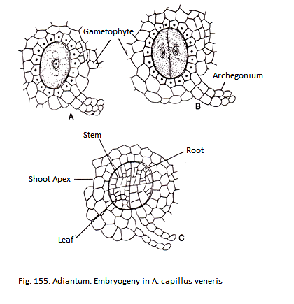
Embryogeny:
The first division of the zygote is vertical. The epibasal half (next to the archegonial neck) forms the leaf and root while the hypo basal half forms the stem’ apex and foot.
Generally only one sporophyte is formed per pro-thallus. During embryogeny the root and juvenile leaves make their appearance first, with the stem differentiat­ing late. The primary root penetrates the soil and establishes itself.

Slide 31
References:
http://www.biologydiscussion.com/pteridophytes/adiantum-occurrence-and-gametophyte-botany/73629
https://en.wikipedia.org/wiki/Adiantum

